Slide 1
Plan, Schedule, Test Community Portal
Module Project
Module: Application Implementation (Agile Project Management)
Course:
Start Date :13-07-2023
End Date : 24-07-2023
Submission Date : 24-07-2023
Learner Name : Syukur Sidiq Nur Alam
Enrollment ID : BDSE0922-089
Presentation Date : 26-07-2023

Slide 2
Contents
Document History
Version Number | Effective Date of release | Summary of Included Changes | Author
1 | 4th March 2016 | First Edition | Satya CVS
2 | 23rd Jul 2018 | Changed for Module 6 | Shrinivas K R

Slide 3
Contents
Contents
S. No. | Description
01 | Different Types of Testing
02 | How Different Testing Helps
03 | Tests Selected
04 | Test Schedule
05 | Test Results
06 | Testing Tools
07 | Project Milestone & Tasks
08 | Milestone Feedback & Action Taken
09 | Modifications Made Based on Feedback
10 | Project Results
11 | Proposed Improvements

Slide 4
1. Different Types of Testing
List types of Testing
A. Functional Testing
UAT Test (User Acceptance Testing):
User Acceptance Testing (UAT) is a functional testing method. This includes testing the software by end users to ensure that it meets their needs and expectations. UAT ensures that your system meets your business needs and is ready for production use.
Compatibility Testing (Cross-Browser Testing):
Compatibility testing, especially cross-browser testing, is a functional testing method. This ensures that the software works as intended across different web browsers and versions. This testing helps ensure that your application's functionality is consistent regardless of which browser your end users are using.

Slide 5
1. Different Types of Testing
B. Non-Functional Testing
Performance Testing:
A non-functional testing technique is performance testing. Evaluate system performance under different conditions such as load, stress and scalability. Software must support the expected user load and provide a responsive and reliable user experience.
Portability Testing (Multiple Devices / Platforms):
Portability testing is a non-functional testing methodology determining the ease or difficulty of moving a software component or application from one environment to another. The test results obtained from Portability Testing help determine how easily a software component from one environment can be used in another environment. The term ‘environment’ refers to moving from one operating system to another operating system, one browser to another browser or from one database version to another database version.

Slide 6
2. How Different Test Helps
UAT Test (User Acceptance Testing): Make sure the software meets your expectations. It is performed to ensure that users' needs are met before the final release. Please give us your valuable feedback for improvement before the official release.
Compatibility Testing (Cross-Browser Testing): Make sure your software works properly in a variety of web browsers. We help developers deliver a consistent experience for all users. Reduce the risk of problems when users access your software using different browsers.
Performance Testing: Check how well the software behaves under different conditions. Identify bottlenecks and issues that can slow down the process. Optimize your software for a smooth and fast user experience.
Portability Testing (Multiple Devices / Platforms):Test whether your software works on different devices and platforms. This makes it easier to move between different environments. Help make your software versatile and accessible to more users.

Slide 7
3. Tests Selected
Functional Testing
UAT Testing
UT Testing
Non-Fucntional testing
Compability Testing
Performance Testing
Portability Testing

Slide 8
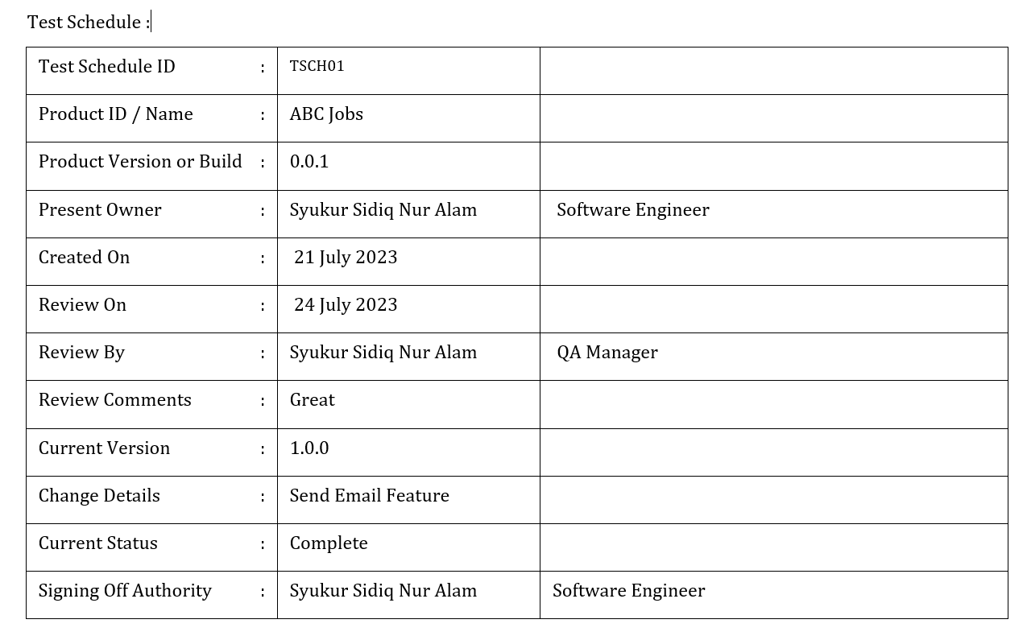
4. Test Schedule

Slide 9
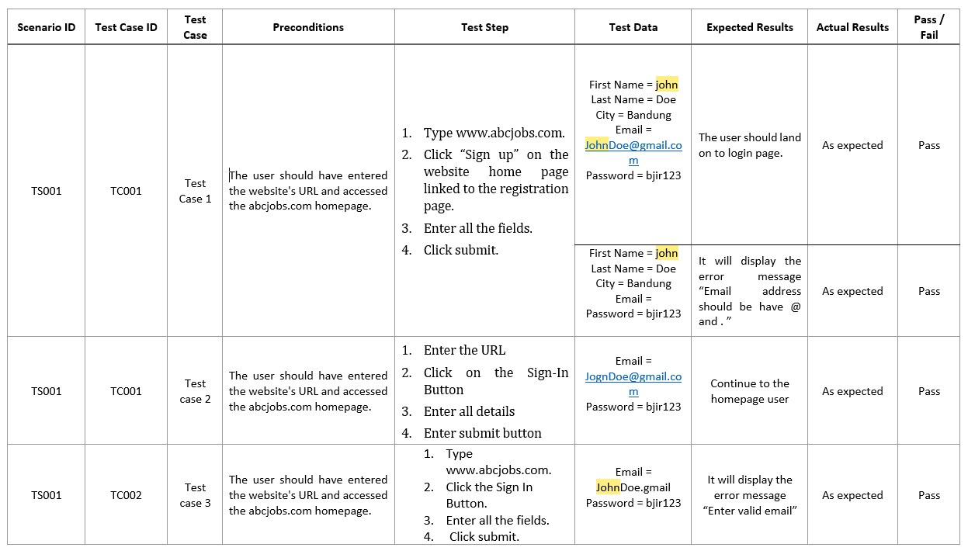
5. Test Results
Unit Testing

Slide 10
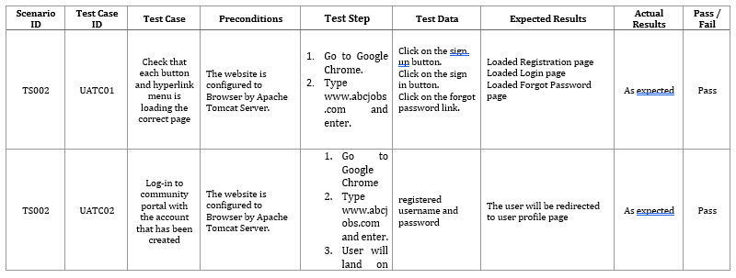
5. Test Results
UAT Testing

Slide 11
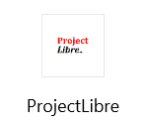

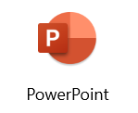


6. Testing Tools
Testing Tools

Slide 12
7. Project Milestones & Tasks
Project Task ID | Project Task Description | Project Milestone ID
1 | Analyze and suggest choice of Test Methods | 1
2 | Schedule the Test Optimally | 1
3 | Develop the Phase Test Plan | 1
5 | Develop Test Cases & Scripts | 2
6 | Execute the Tests & Document the results | 3

Slide 13
8. Milestone Feedback & Action taken
Project Milestone ID | Milestone Feedback received from Tutor / Learning Facilitator | Action Taken (Yes / No)
1
2
3

Slide 14
9. Modifications Made based On Feedback

Slide 15
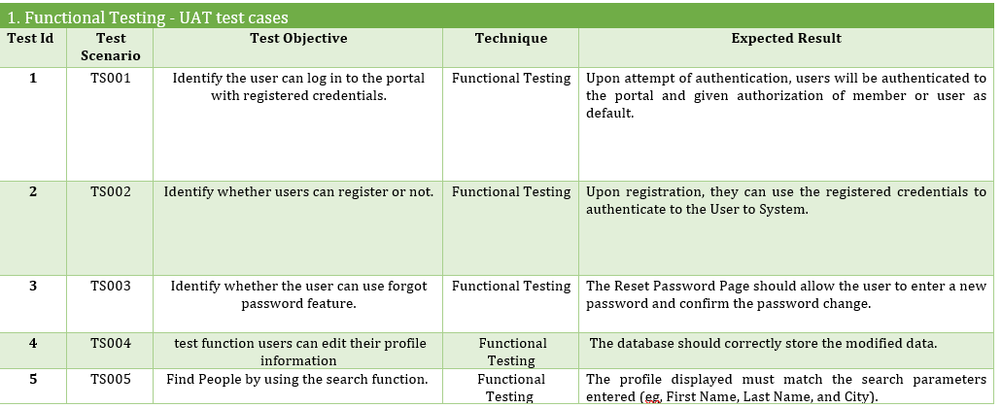
10. Project Results

Slide 16
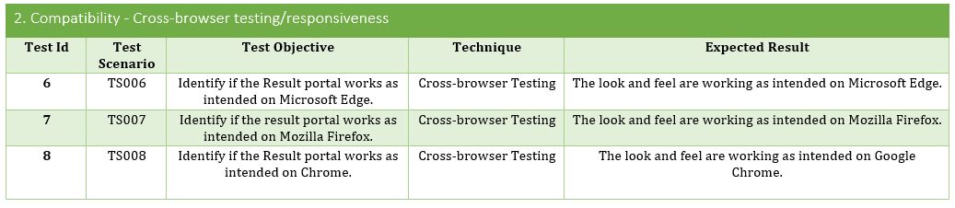
10. Project Results

Slide 17
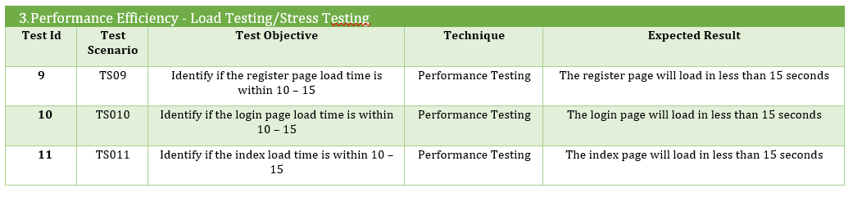
10. Project Results

Slide 18
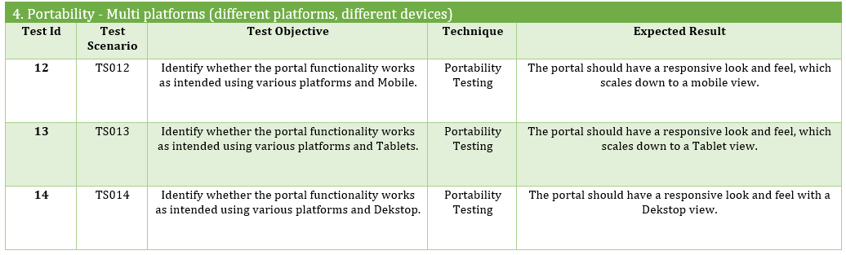
10. Project Results

Slide 19
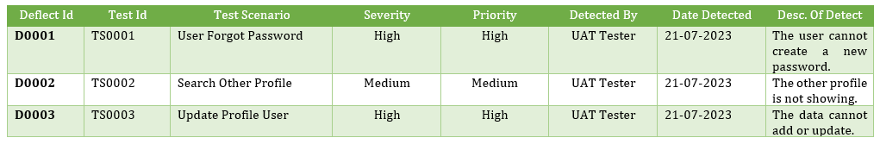
10.Project Result
Defect Report

Slide 20
11. Proposed Improvements
List of Improvements
Update the waterfall model again specifically and according to the plan
Learn to use other SDLC models and compare them with the Waterfall model.

